Slide 1
General Random Processes and Spectral Analysis

Slide 2
topics
Extension from random variables to processes
Statistical characterization of random processes
Time domain and frequency domain analysis
Stationarity and ergodicity properties
Power spectral density analysis
Key random process classifications

Slide 3
Random Process Vs. Random Variable
recording a video
single photo
A collection or sequence of random variables indexed by time (or space)
Produces an entire function or signal for each experiment/trial
Each point in time gives you a different random variable
Can be described by joint distributions across multiple time points
A single random quantity that takes different values based on chance
Has a single outcome for each experiment/trial
Can be described by its probability distribution
Examples: Result of rolling a die, temperature at noon today
If X(t) is a random process, then X(t₀) for any specific time t₀ is a random variable
A random process X(t) can be viewed as a family of random variables indexed by the parameter t

Slide 4
Random Process Vs. Random Variable
recording a video
single photo
If X(t) is a random process, then X(t₀) for any specific time t₀ is a random variable
A random process X(t) can be viewed as a family of random variables indexed by the parameter t.

Slide 5
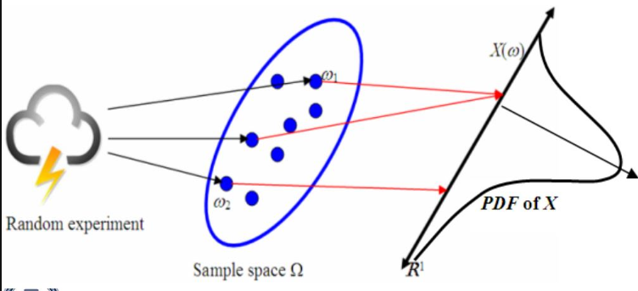
Random Process
Stock market prices going up and down
Static noise on a radio
Weather patterns changing day to day

Slide 6
stochastic Process
stochastic in English was originally used as an adjective with the definition "pertaining to conjecturing“. Greek

Slide 7
stochastic Process
family of random variables in a probability space, where the index of the family often has the interpretation of time.

Slide 8
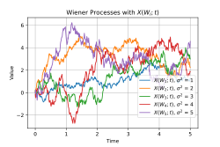
stochastic Process
Wiener process or Brownian motion process
study price changes on the Paris Bourse.

Slide 9
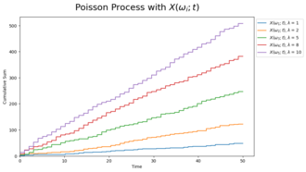
stochastic Process
Poisson process
study the number of phone calls occurring in a certain period of time.

Slide 10
stochastic Process
Poisson process
Bernoulli process
branching processes
Random walk
renewal processes
random fields
Gaussian processes
Markov processes
Lévy processes

Slide 11
Random Processes
A function that assigns a real number to each outcome.
In the sample space of random experiments, described by Collection of random variables X(t), t ∈ T
X ∈ F (T, -∞, +∞)
X ∈ R (Ω, -∞, +∞)
Each random variable in the collection takes values from the same mathematical space known as the state space

Slide 12
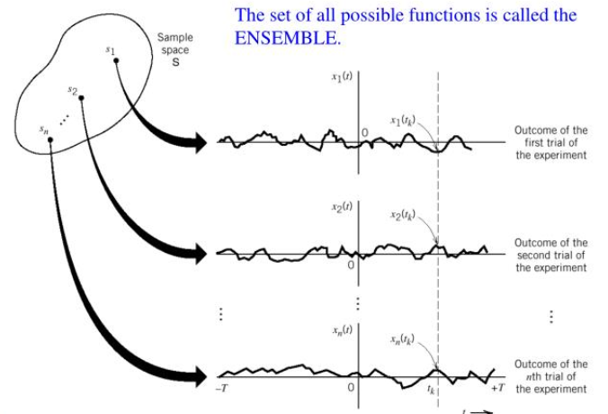
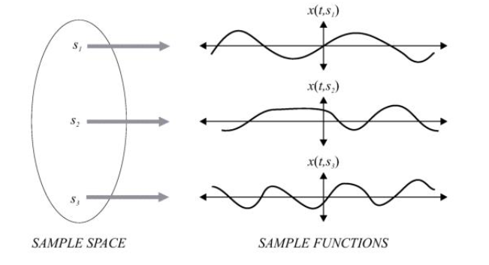
Random Processes

Slide 13
dimension
Fourier analysis
Non-Time Indexing
RP dimension??????

Slide 14
Non-Time Indexing
X(Y(t)) ‘Markov chain’

Slide 15
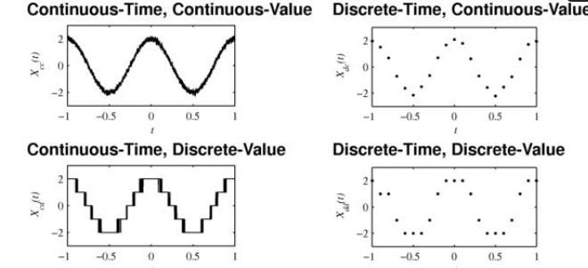
Types of Random Processes
Discrete random processes
Continuous-time random processes

Slide 16
Discrete random Processes
Is a random variable with a finite or countable range of values.
• The possible values of X may be listed as {x1,x2, . .}

Slide 17
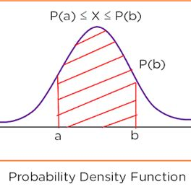
Continuous Random Processes
X takes in any of real values, not in a discrete set.
Density function: f(x)
P(a ≤ X ≤ b) = ∫ₐᵇ f(x)dx

Slide 18
Statistical Characterization
Mean function: μₓ(t) = E[X(t)]
Autocorrelation: Rₓ(t₁,t₂) = E[X(t₁).X(t₂)]
Autocovariance: Cₓ(t₁,t₂) = E[(X(t₁)-μₓ(t₁)).(X(t₂)-μₓ(t₂))]

Slide 19
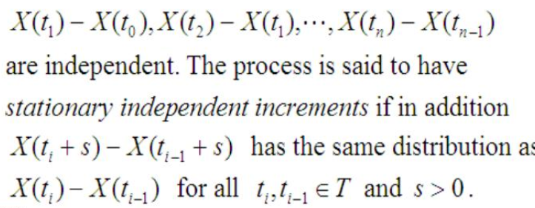
Stationarity

Slide 20
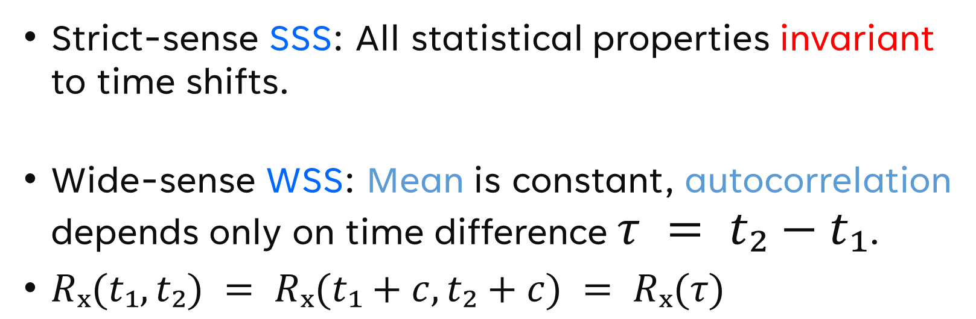
Stationarity
Strict-sense SSS: All statistical properties invariant to time shifts.
Wide-sense WSS: Mean is constant, autocorrelation depends only on time difference $τ = t₂−t₁$.
$Rₓ(t₁,t₂) = Rₓ(t₁+c,t₂+c) = Rₓ(τ)$

Slide 21
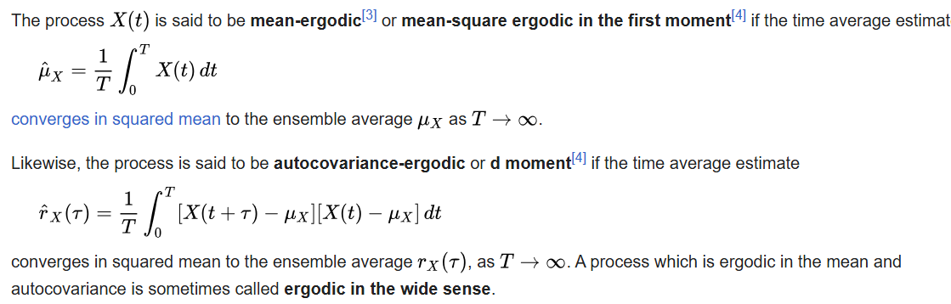
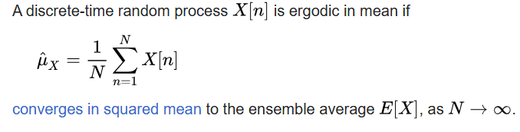
Ergodicity

Slide 22
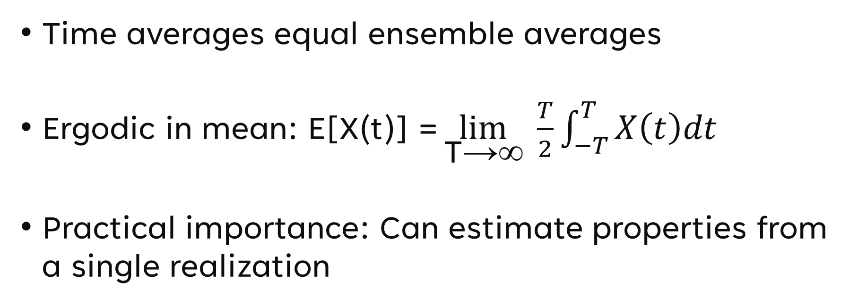
Ergodicity
Time averages equal ensemble averages
Ergodic in mean: $\text{E}\text{[}\text{X}\text{(}\text{t}\text{)] =}\lim_{\text{T}\text{→∞}}{ \frac{T}{2}\int_{−T}^{T}{X\left(t\right)dt}}$
Practical importance: Can estimate properties from a single realization
The term "ensemble" is often used in physics and the physics-influenced literature. In probability theory, the term probability space is more prevalent.

Slide 23
Ergodicity
Practical importance: Can estimate properties from a single realization
multiple independent recordings to estimate statistics
one long recording of a signal
we can use time averaging on a single, sufficiently long sample path.

Slide 24
Ergodicity
Practical importance: Can estimate properties from a single realization
Ex. When analyzing noise in an electronic circuit, ergodicity allows engineers to characterize the noise properties by taking a single long measurement rather than repeating the experiment many times.

Slide 25
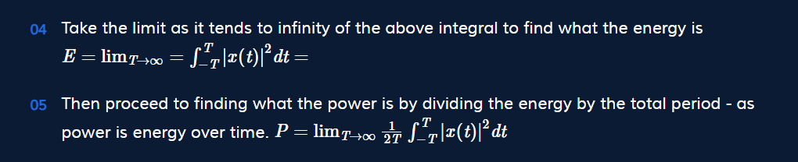
Power Spectral Density
periodic signals can be analyzed using Fourier series, while non-periodic signals can be analyzed using Fourier transform.

Slide 26
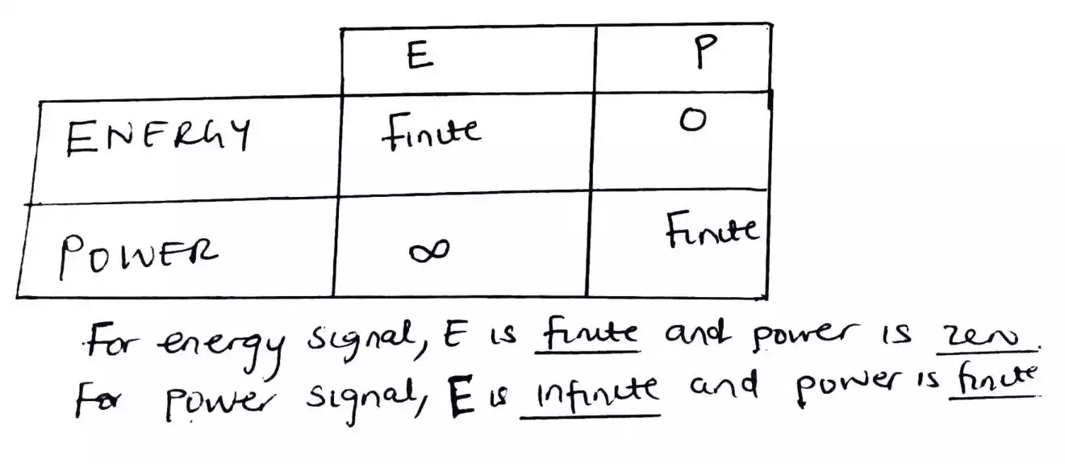
Power Spectral Density
Neither energy nor power signals: Infinite energy, infinite power
Often power signals.

Slide 27
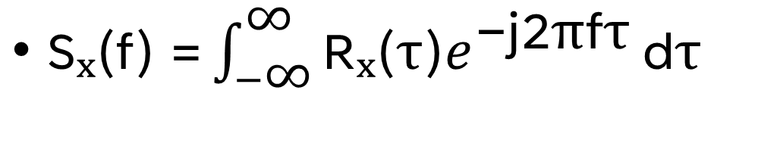
Power Spectral Density
$\text{S}\text{ₓ(}\text{f}\text{) =}\int_{−\text{∞}}^{\text{∞}}{\text{R}\text{ₓ(}\text{τ}\text{)}e^{\text{−}\text{j}\text{2}\text{π}\text{f}\text{τ}}}\text{d}\text{τ}$
Fourier transform of autocorrelation function.
Describes power distribution across frequency
Wiener-Khinchin theorem: Rₓ(τ) ↔ Sₓ(f)

Slide 28
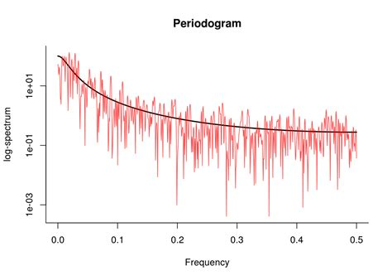
Spectral Estimation
Periodogram method
Welch's method (segmentation and averaging)
Blackman-Tukey method (windowing)
Maximum Entropy method

Slide 29
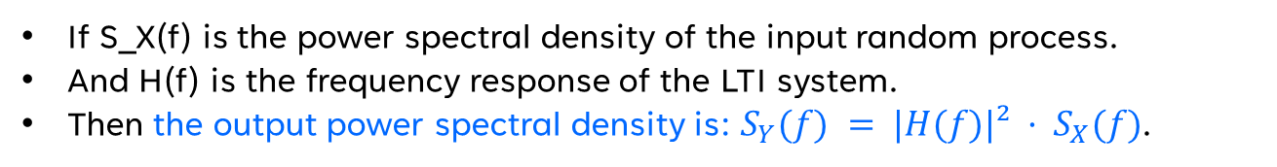
LTI Systems
Random processes can be inputs to LTI systems:
When a random process passes through an LTI system, the output is also a random process
Output relationship
If X(t) is a random process input to an LTI system with impulse response h(t), the output Y(t) is:
Y(t) = X(t) * h(t) (where * represents convolution)
Spectral properties
If S_X(f) is the power spectral density of the input random process.
And H(f) is the frequency response of the LTI system.
Then the output power spectral density is: $S_{Y}(f) = |H(f)|² · S_{X}(f)$.
Filtering noise
Bandlimiting
Understanding how systems affect signal content at different frequencies

Slide 30
Key Process Classes
Gaussian process: Characterized by mean and autocorrelation ‘multivariate normal distribution’.
White noise: Uncorrelated samples, flat PSD spectrum.
Markov process: Future depends only on present state ‘causal’, ‘state space’.
Poisson process: Models random events at fixed rate λ ‘Memoryless in time between events’.

Slide 31
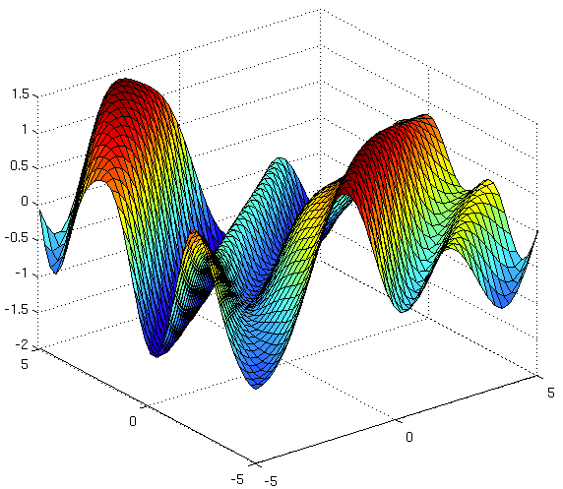
Gaussian process
Characterized by mean and autocorrelation
‘multivariate normal distribution’
Finite-Dimensional Distributions are Jointly Gaussian
Machine learning (like Gaussian Process Regression)
Control and estimation (Kalman filter assumes Gaussian)Signal modeling (e.g., modeling thermal noise)

Slide 32
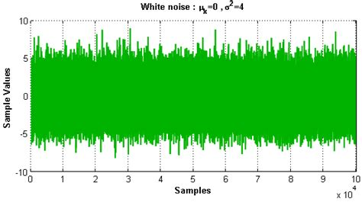
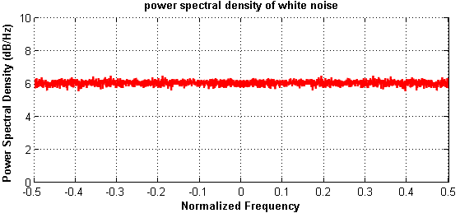
White noise
Uncorrelated samples
Uncorrelated at All Different Times
flat PSD spectrum
‘causal’, ‘state space’

Slide 33
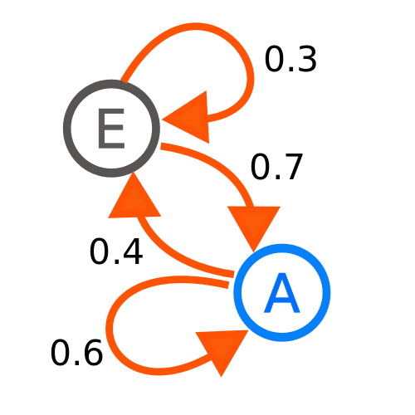

Markov process
The future state only depends on the current state, not the full history (or any future states).
There’s no dependence on future information.
‘causal’, ‘state space’

Slide 34
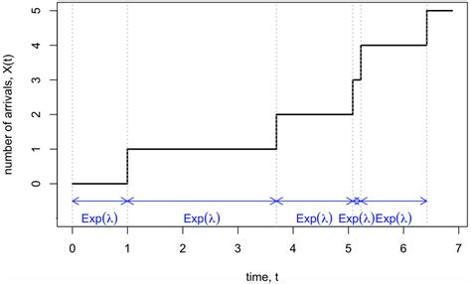
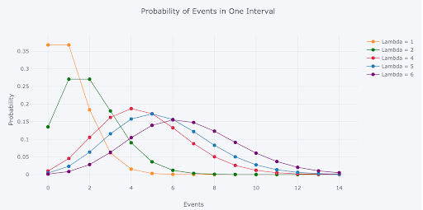
Poisson process
Counts the number of events that occur in a given time interval.
The times between events (interarrival times) are exponentially distributed.
And the exponential distribution is memoryless.
distribution function

Slide 35
Applications of Spectral Analysis
Signal processing and filtering
Communication systems design
System identification
Noise analysis and characterization
Time series forecasting

Slide 36
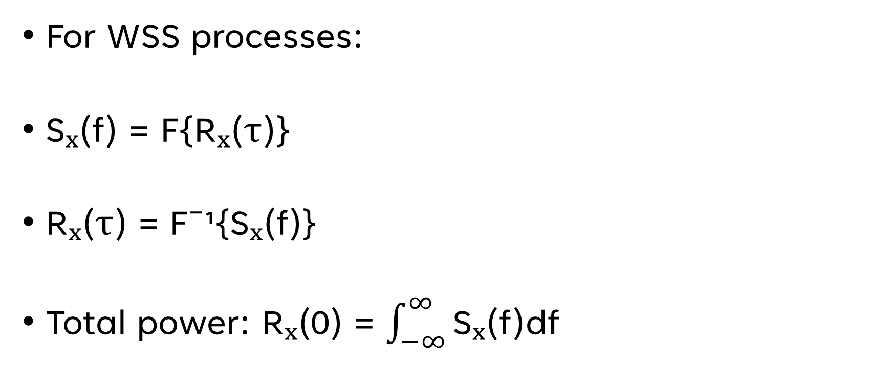
Wiener-Khinchin Theorem
For WSS processes:
Sₓ(f) = F{Rₓ(τ)}
Rₓ(τ) = F⁻¹{Sₓ(f)}
Total power: Rₓ(0) = $\int_{−∞}^{∞}{\text{S}\text{ₓ(}\text{f}\text{)}\text{df}}$

Slide 37
Summary
Random processes extend random variables to signals
Statistical properties characterize random processes
Spectral analysis provides frequency domain perspective
PSD is fundamental to random signal analysis
Links theoretical concepts to practical applications.

Slide 38
Thank you

